Slide 1
Atliq hardware sales insight from ad-hoc request
Md Rafeul Islam
3rd Dec 2023

Slide 2
AGENDA
Introduction
Insights
Conclusion
Queries
Appendix

Slide 3
INTRODUCTION
Atliq Hardware, a leading computer hardware producer in India, has expanded globally. Recently, the company has made a strategic move to adopt SQL, driven by the need to efficiently manage vast amounts of data and gain valuable business insights for effective business management.

Slide 4
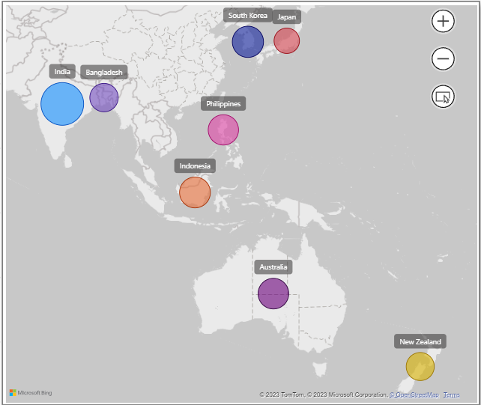
INSIGHT
Q1. List of Markets Where Customer “Atliq Exclusive” Operates Business in “Asia Pacific” Region for Fiscal Year 2020-2021.
In the Asia-Pacific region, Atliq Exclusive experiences the highest Gross Sales in India, leading among 8 countries. South Korea, Indonesia, Australia, and others followed suit.

Slide 5
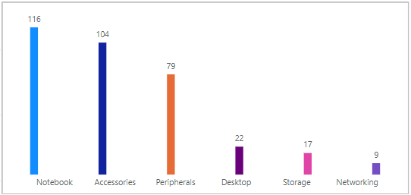
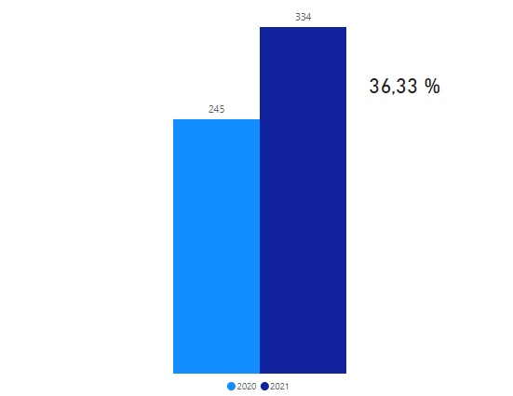
INSIGHT
Q2. Change in the Number of Unique Products
Q3. Unique Products in Each Segment
Atliq Hardware Has A Very Low Number Of Unique Products In The Desktop, Storage, And Networking Segment.
We Observed That 36.33% Of Unique Products Increased In 2021.

Slide 6
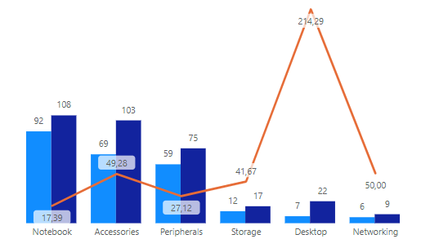


INSIGHT
Q4. Which segment had the most increase in unique products in 2021 vs 2020?
Q5. Get The Products That Have The Highest And Lowest Manufacturing Costs.
Product With Max Manufacturing Cost- AQ Home Allin1 Gen2 (240,54$)
Product With Minimal Manufacturing Cost- AQ Master Wired X1 MS (0,89$)
Analysis Showed The Highest Increase In The Desktop Segment, Whereas Other Segment Categories Had Increased In Unique Products By Around 50 Percent.

Slide 7
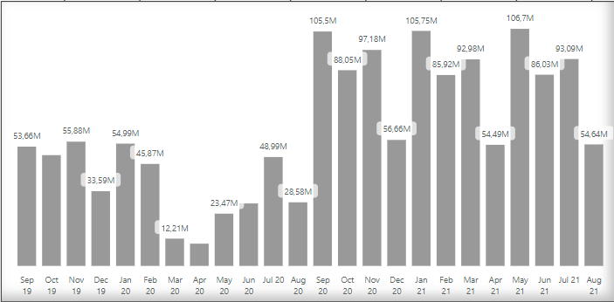
INSIGHT
Q6. Top 5 Customers Who Received An Average High Pre-invoice Discount Percentage For The Fiscal Year 2021in India
Q7. Get the complete report of the Gross sales amount for the customer “Atliq Exclusive” for each month.
Customer Name | Average Percentage
Flipkart | 29.55%
Ezone | 28.20%
Vijay Sales | 28.18%
Viveks | 27,25%
Atliq Exclusive | 27.16%
The Bar Chart For Atliq Exclusive Indicates The Growth In Sales After The COVID-19 Pandemic.

Slide 8
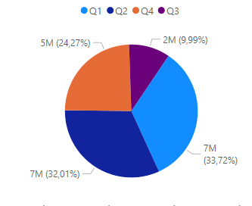
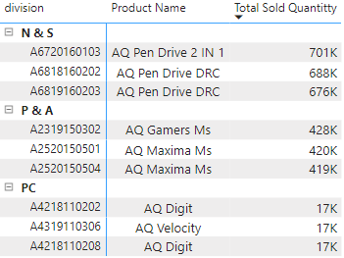
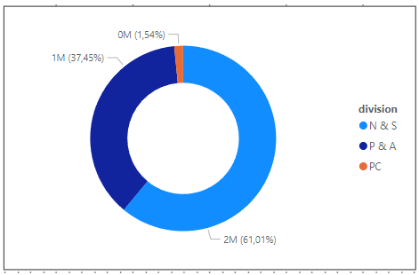
INSIGHT
Q8. IN WHICH QUARTER OF 2020, GOT THE MAXIMUM TOTAL SOLD QUANTITY?
Q9. WHICH CHANNEL HELPED TO BRING MORE GROSS SALES IN THE FISCAL YEAR 2021 AND THE PERCENTAGE OF CONTRIBUTION?
The 4th Quarter of the year significantly sold less quantity.
Retailer Channel helped to bring the most sales
Q10. Top 3 products in each division with the highest quantity sold in fiscal year 2021

Slide 9
SUMMARY
Atliq Hardware Had A Successful Year In 2021, Launching 102 New Products.
After The Covid-19 Pandemic There Is A Substantial Growth Visible In Gross Sales, Where 78% Of Products Sold Through The Retailer Channel.
The Fourth Quarter Was The Lowest Quantity Product And Pc Division Require More Attention To Improve Its Sold Quantity.
To Boost Gross Sales, Consider Adjusting Discount Rates Strategically. Additionally, Explore Opportunities To Expand E-commerce Sales By Collaborating With New Platforms And Offering Competitive Discounts

Slide 10
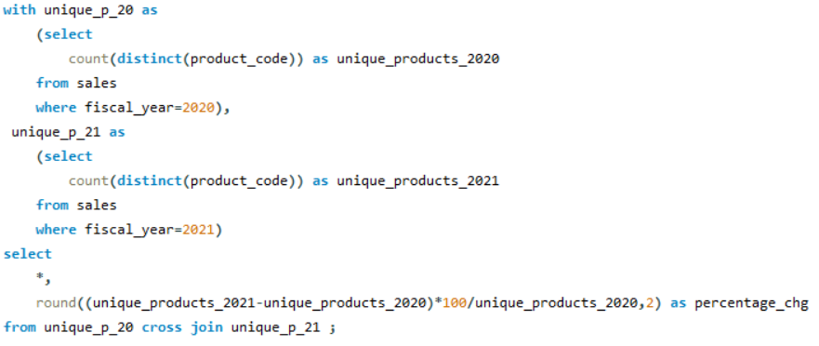
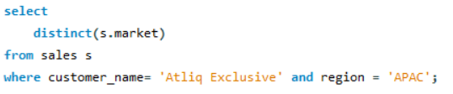


QUERIES
Create a view 'sales' field consisting of date, customer_code, customer_name, product_code, product, variant, segment, sold_quantity, fiscal_year, market, region.
To reduce query size and simplify the query readability.
1. Provide the list of markets in which customer "Atliq Exclusive" operates its business in the APAC region.
2. What is the percentage of unique product increase in 2021 vs. 2020?

Slide 11
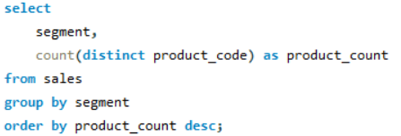
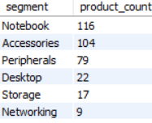
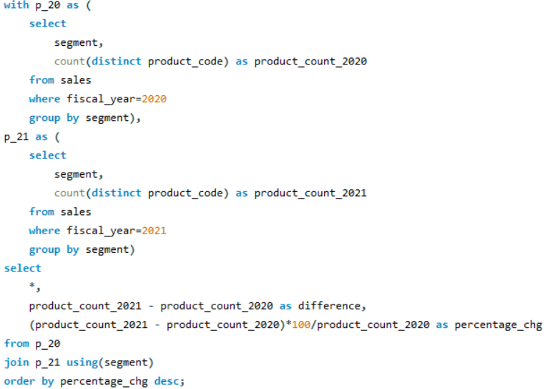
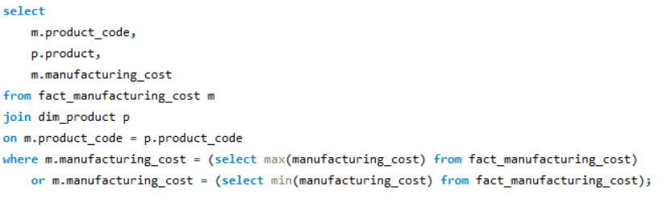

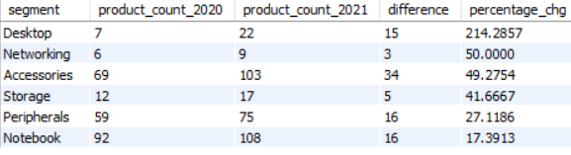
QUERIES
Q3. Unique Products in Each Segment
Q4. Which segment had the most increase in unique products in 2021 vs 2020?
Q5. Get The Products That Have The Highest And Lowest Manufacturing Costs.

Slide 12
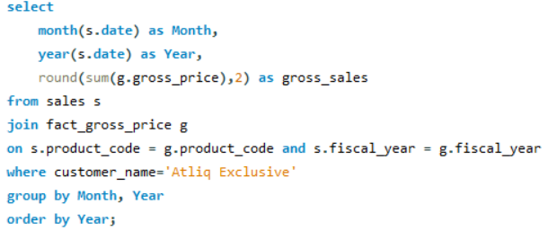
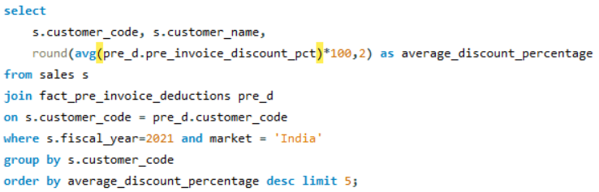
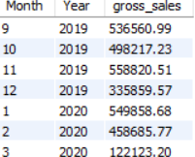
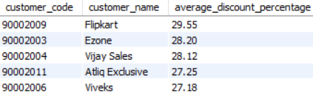
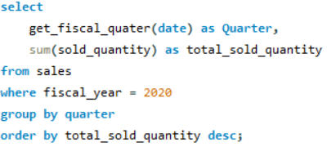
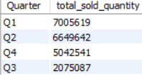
QUERIES
Q6. Top 5 Customers Who Received An Average High Pre-invoice Discount Percentage For The Fiscal Year 2021in India
Q7. Get the complete report of the Gross sales amount for the customer “Atliq Exclusive” for each month.
Q8. IN WHICH QUARTER OF 2020, GOT THE MAXIMUM TOTAL SOLD QUANTITY?

Slide 13
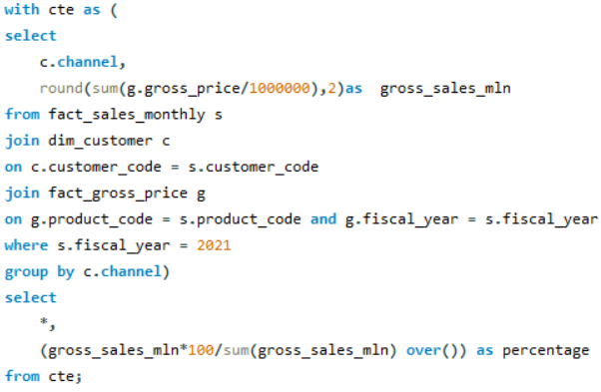
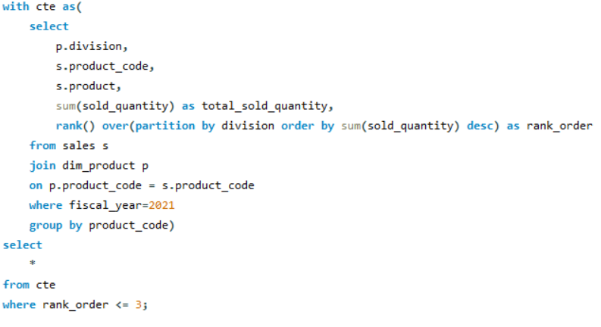
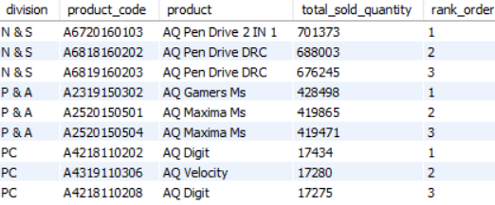

QUERIES
Q9. WHICH CHANNEL HELPED TO BRING MORE GROSS SALES IN THE FISCAL YEAR 2021 AND THE PERCENTAGE OF CONTRIBUTION?
Q10. Top 3 products in each division with the highest quantity sold in fiscal year 2021

Slide 14
APPENDIX
PROJECT ON GITHUB:
https://github.com/mdrafeul/SQL--Ad-hoc-Request-Challenge.git
WEB LINK:
https://codebasics.io/portfolio/Md-Rafeul-Islam

